Slide 1
A Quick Refresher
~ Krishna Balaga
Watson and Cloud Developer
krbalaga@in.ibm.com

Slide 2


Slide 3
History of cloud development
Increasingly advanced cloud technologies have led companies to entrust more and more of their IT activities to service providers
On-premises
IaaS
PaaS
Serverless
Servers & storage
Security
OS & software
Dev tools
Apps & services

Slide 4
Stateful vs Stateless

Slide 5
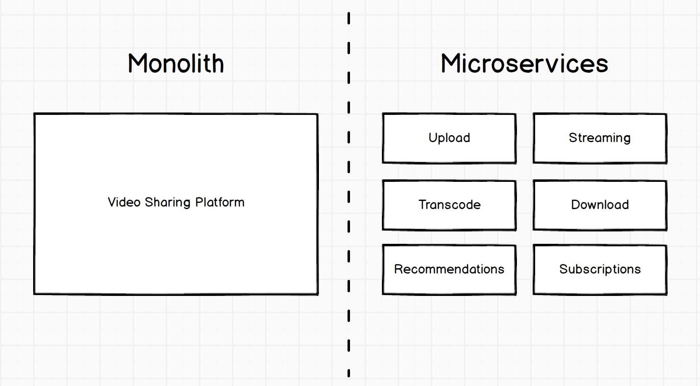

Slide 6
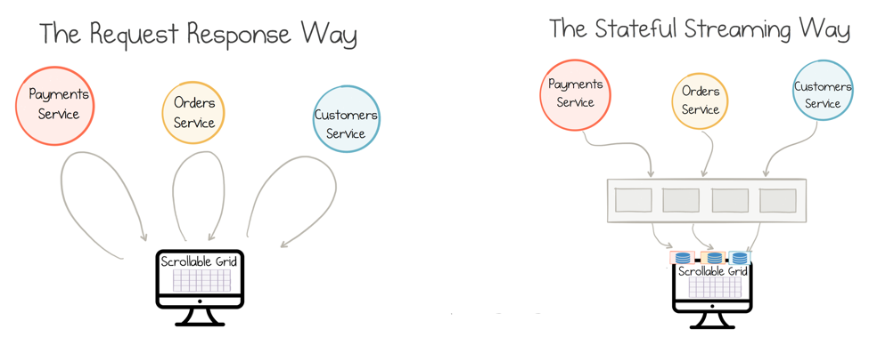

Slide 7
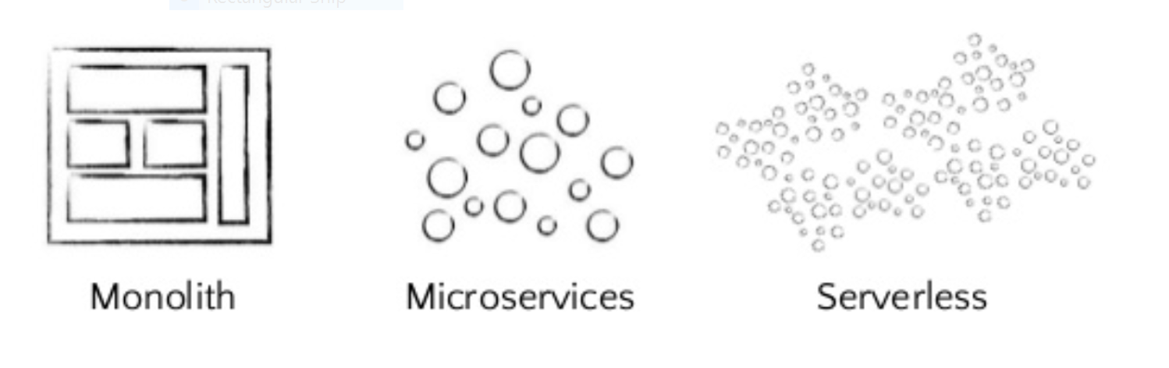

Slide 8
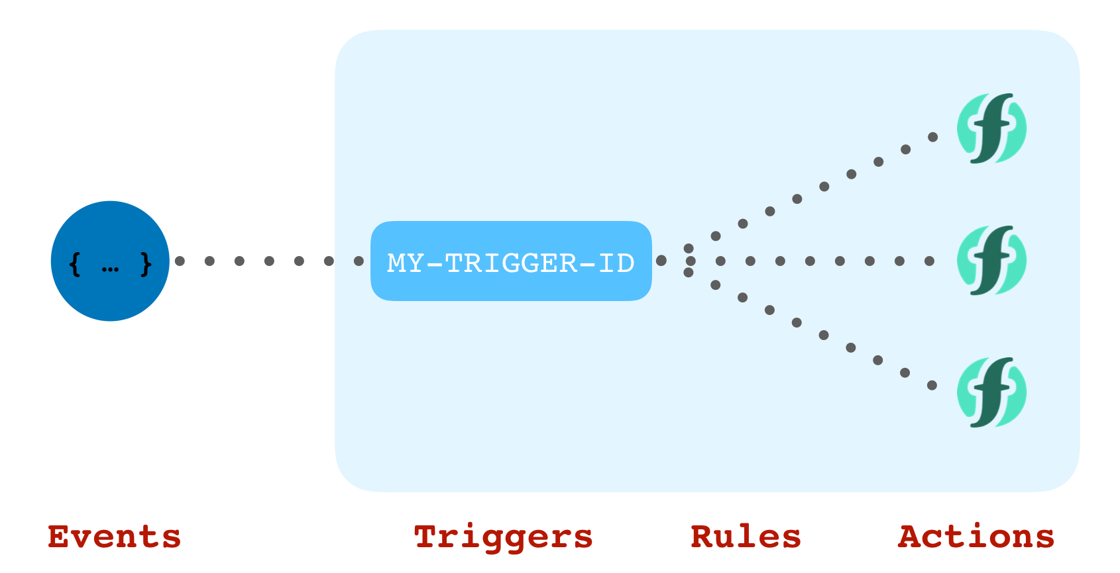
Serverless

Slide 9
Advantages
Continuous integration and continuous delivery
Auto scalable and no monitoring required
No server management is necessary
Developers are only charged for the server space they use, reducing cost
Code can run closer to the end user, decreasing latency

Slide 10
When not to “serverless”?
Whenever you need real time that matters at the business level (you can do asynchronous)
Whenever you need a long running task that can’t be split into multiple compute cycles
Whenever you need complex compute with high memory/compute requirements
Whenever you need a really good speed of response
Whenever you need reliability where you can’t guarantee service availability to a high enough level.

Slide 11
Some Use-cases

Slide 12
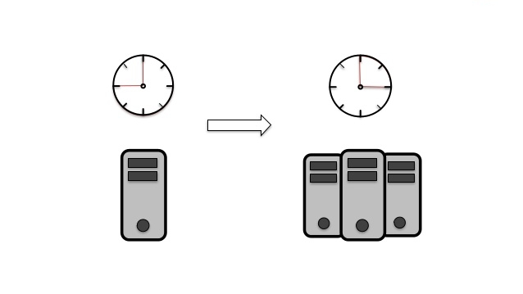
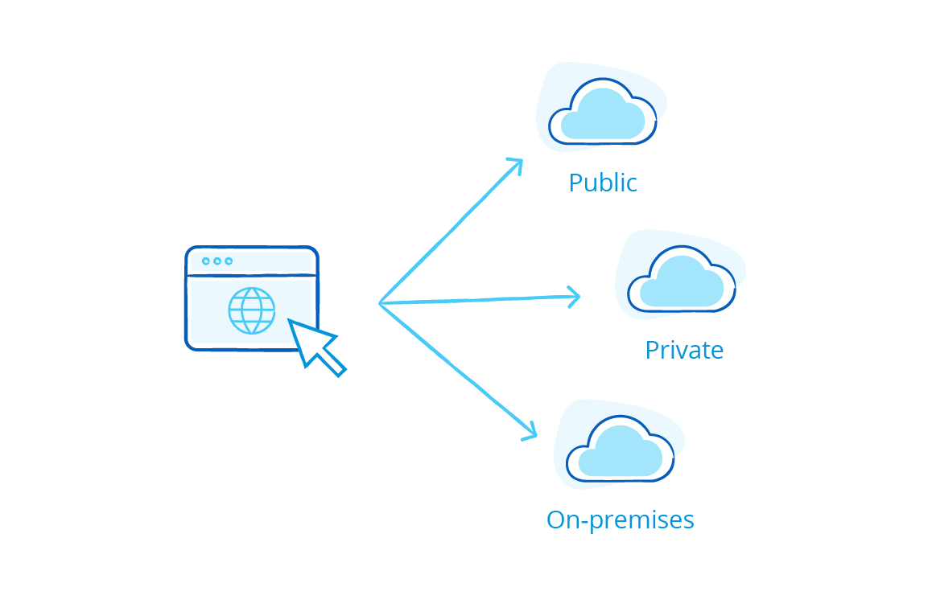

Use-cases
Media Resizing
Dynamic Scalability
Multi-Cloud

Slide 13

Error handling

Slide 14
Case-studies

Slide 15

On Upload, Netflix triggers an event calling a function that splits the video into
5-minute chunks that get encoded into 60 different parallel streams that Netflix needs.
Thousands of files get modified on a daily basis.
Functions are checking if the files need to be backed up,
they check the validity and integrity of the files.
Netflix has thousands of processes that stop and start instances
Functions are used to validate that each instance is constructed
accordance with the system’s rules and regulation
They also use Functions to create alerts and shutdown in the event
of a unauthorized access.
Functions are responsible for the server deployment, compliance, and configuration

Slide 16


750 employees that manages software,
They have a check depositing image recognition app
that handles billions of dollars in transactions a year.
Even Invoices are being managed
They are running 287 functions, 19 microservices
with 3.68 TB of data at the mere cost of
$580 per month

Slide 17
Thank you!
github.com/krishnac7/serverlessRefresher
Krishna Balaga
krbalaga@in.ibm.com

